Slide 1

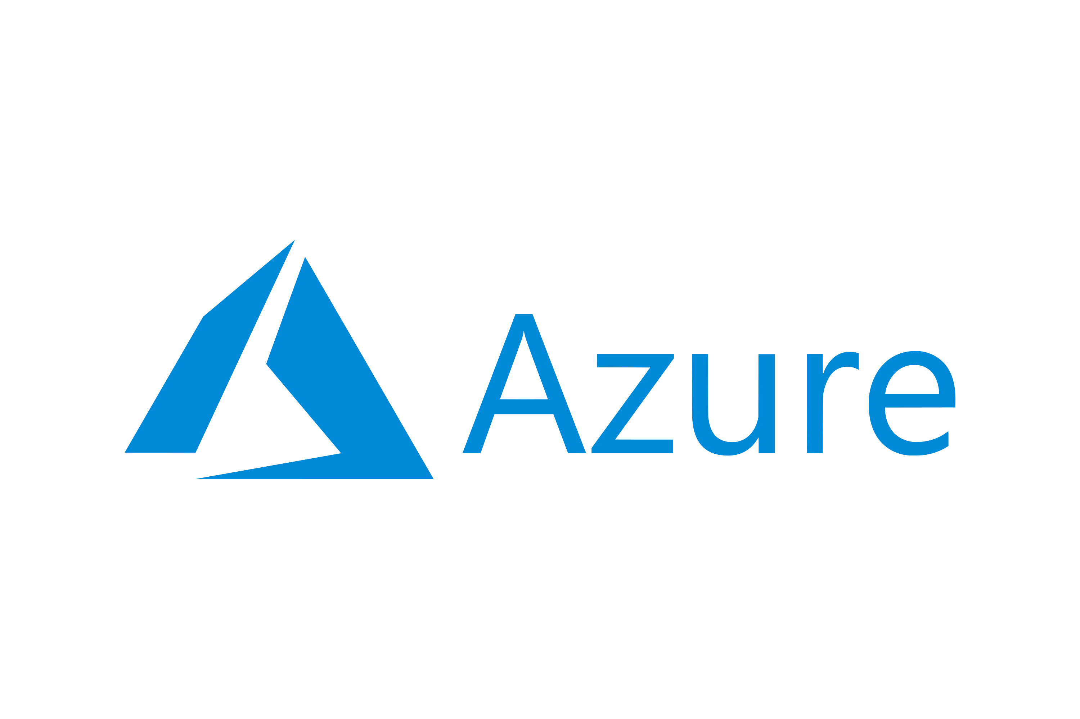
DEPI Project
Hub & Spoke Architecture
(Global O3M)

Slide 2

Our Agenda

Slide 3
1
Project Case & Customer requirement
2
Our Solution
3
Traffic Direction
4
Demo

Slide 4

Business Case
A rapidly growing company in the Marketing
& Sales Field [O3M Company ]
Problem Statement
Scalability limitations
Performance bottlenecks
Increased operational costs
CapEx-OpEx
Security concerns
Goal

Slide 5
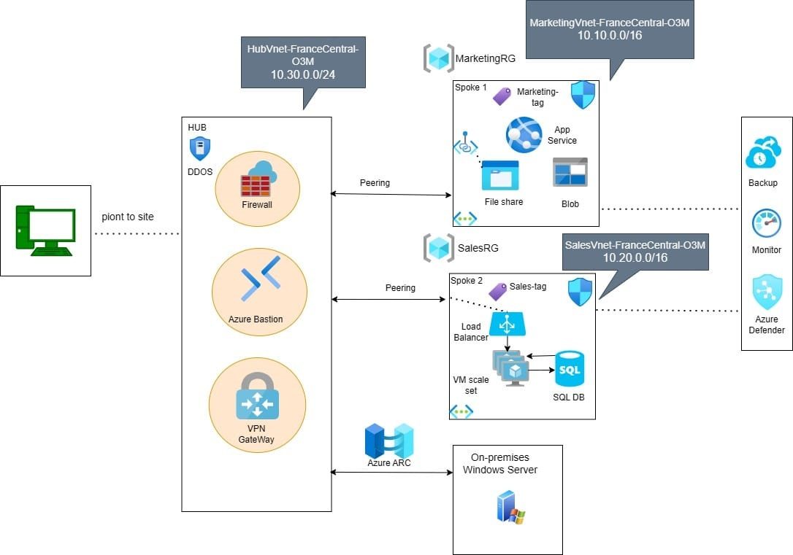
Hub and Spoke Architecture
Central Management
Scalability
Cost savings
Overcoming subscription
limits by workloads isolation

Slide 6
Company Requirements
Hosting a Static Web App For Company Details and its Marketing Options
Store a type Data to be accessible to the Department Employees only

Slide 7
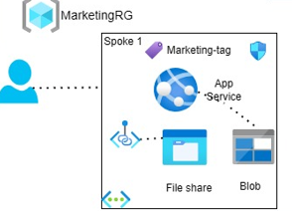
Marketing Spoke
Azure App Service
Storage Account
Blob
File Share

Slide 8
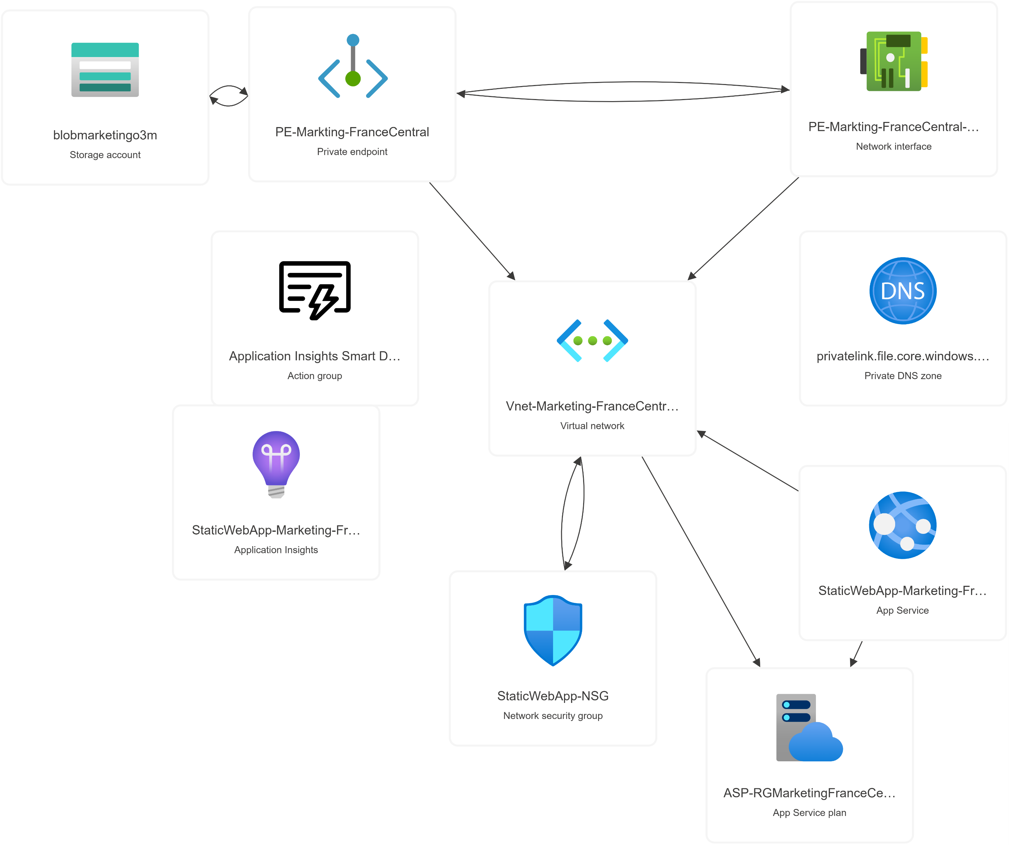

Slide 9
Sales Spoke
Requirements
Components
Purpose

Slide 10
Requirements
Internal System For Sales
Application and Database
Employees works from Home in specific Days
Security and Cost are Priority for that System

Slide 11
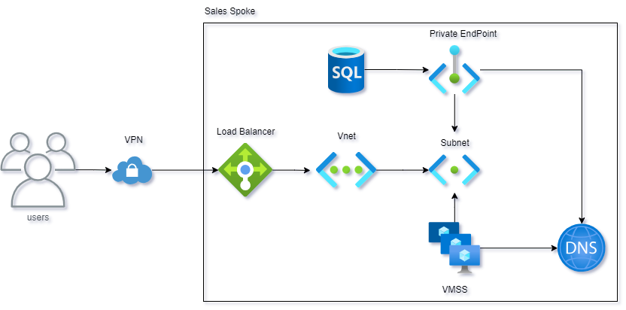
Components
VMSS for web site
Azure DB
Load Balancer
Private Endpoint
DNS Private Zones

Slide 12
Purpose
Why VMSS
Azure SQL Role
Internal Load Balancer Roles
Private Endpoint Role
DNS Private Zones

Slide 13
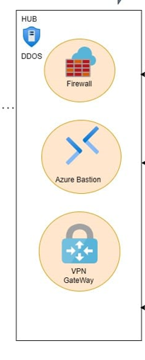
Shared services (hub)
Azure Firewall
Azure Bastion Host
Azure virtual gateway VPN

Slide 14
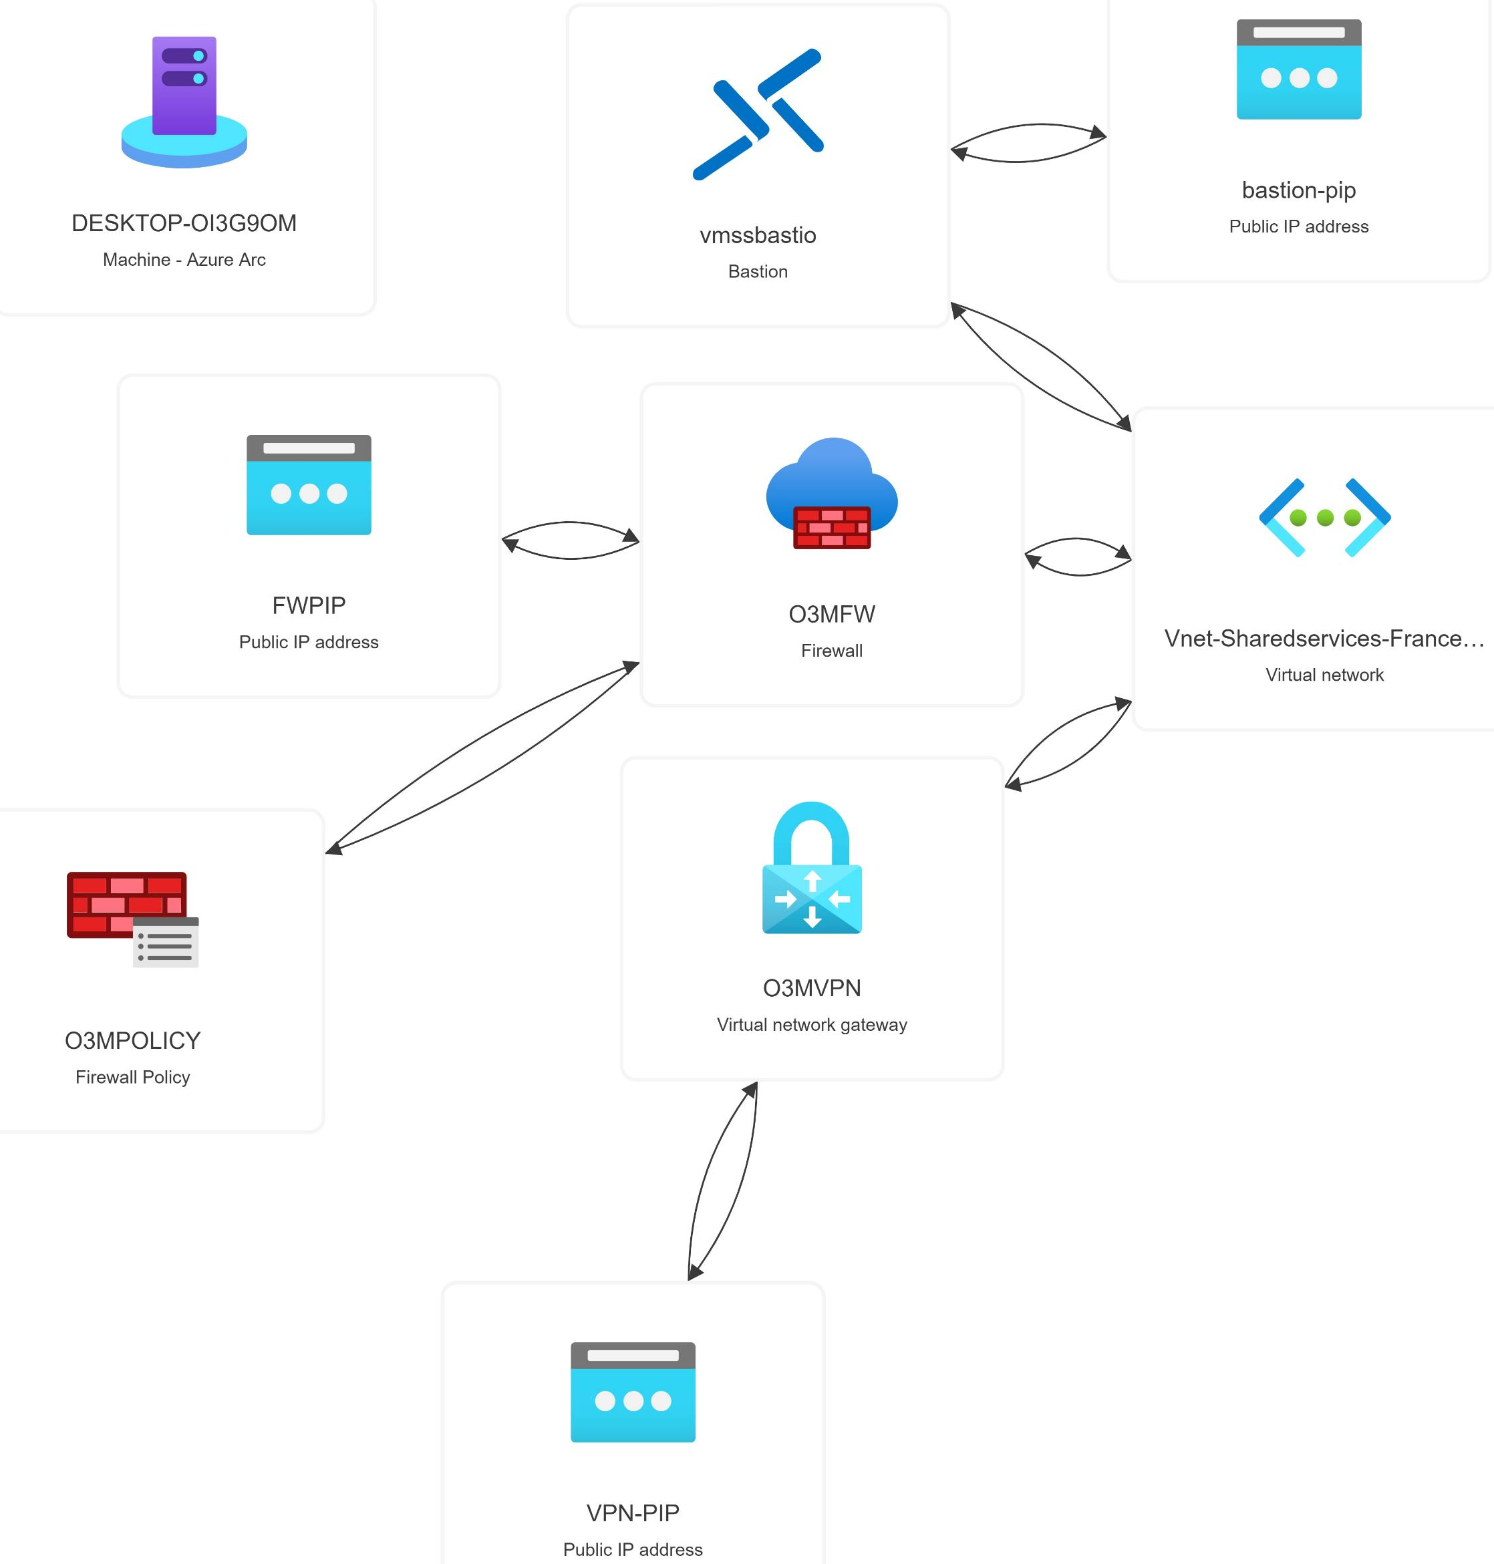

Slide 15
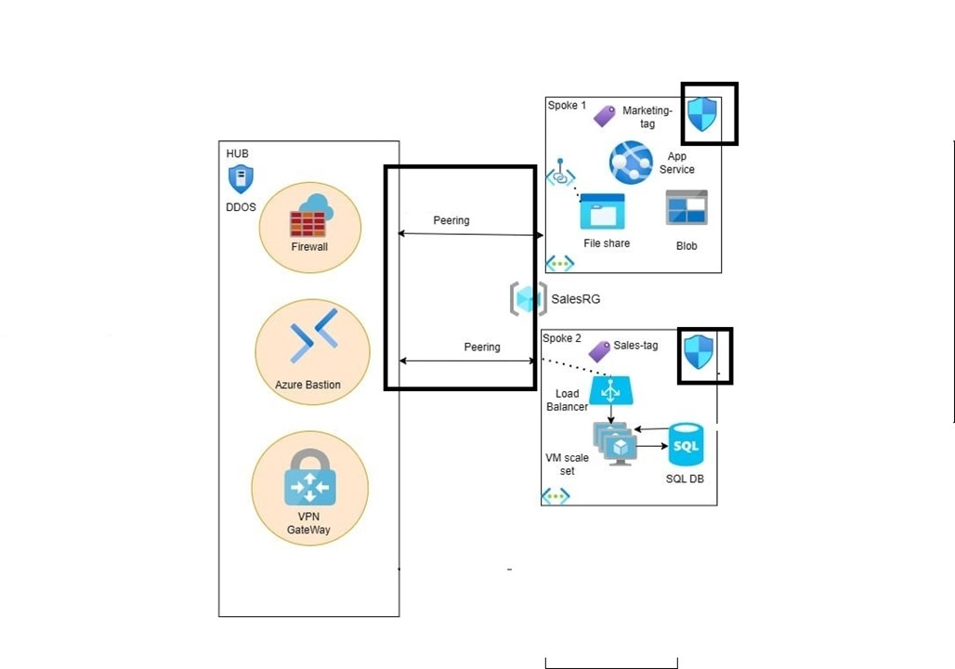
Secure Connectivity between hub and spokes
peering
secure and efficient connectivity
low latency
high bandwidth

Slide 16
Centralized Firewall
Control Traffic
DNAT Rule
Network Rule
App Rule
Enable DDOS protection

Slide 17
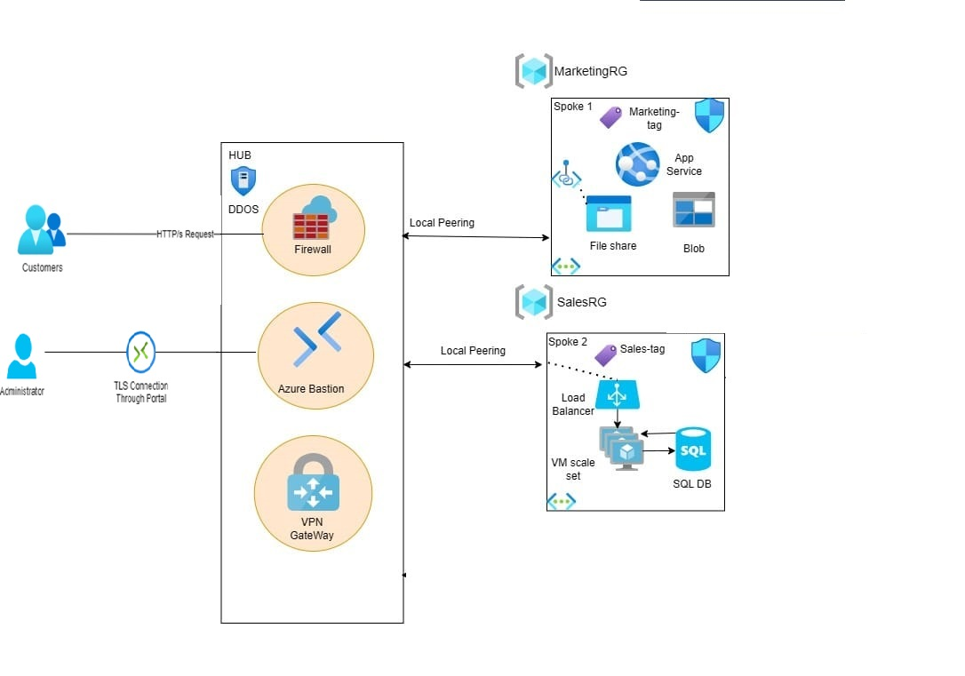
Secure Remote Access To VM
secure solution for RDP/SSH
connectivity to the virtual machines
Azure Bastion host

Slide 18
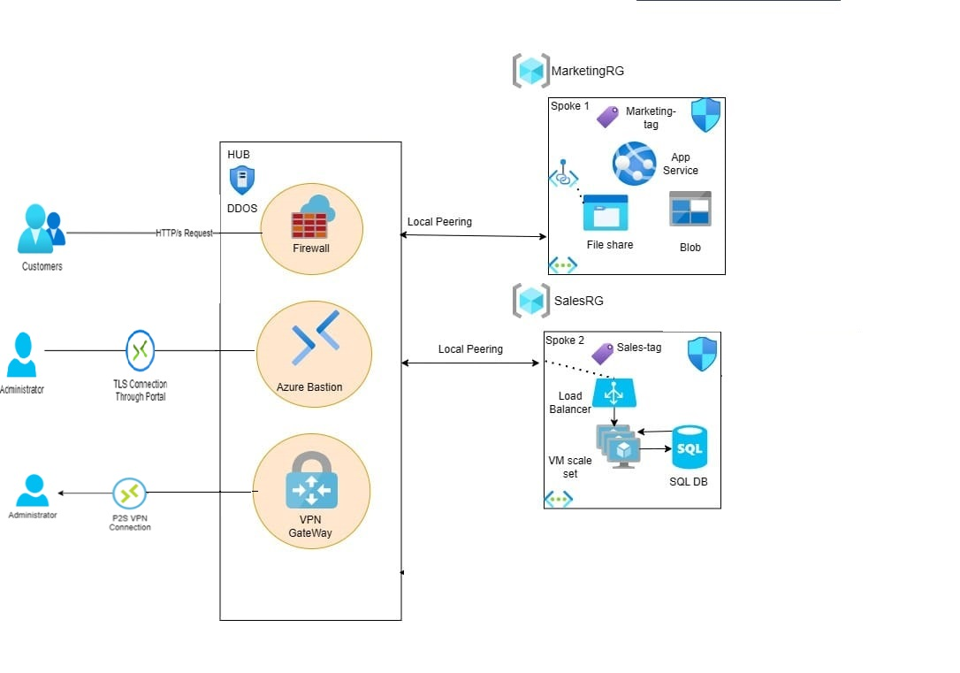
Secure Connectivity to on premises
Implemented a VPN Gateway to establish a secure connection
Configured a site-to-site (S2S)
Created a point-to-site (P2S) VPN

Slide 19
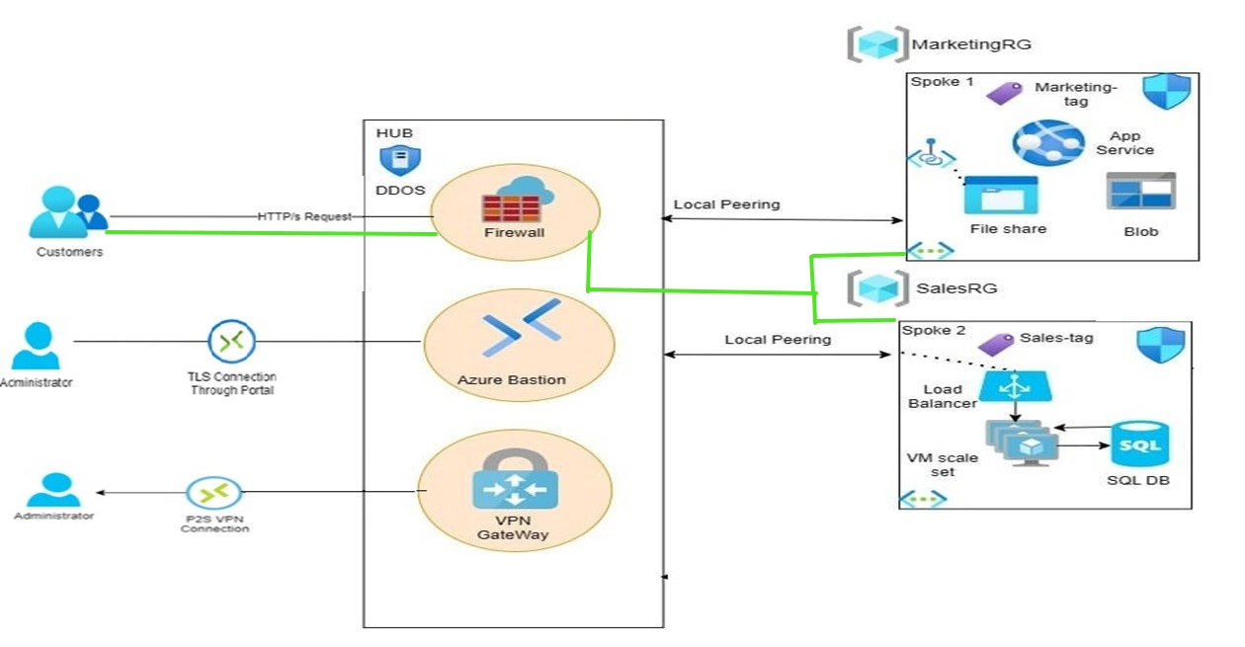
Traffic Direction
HTTP/s Traffic from Public Internet

Slide 20
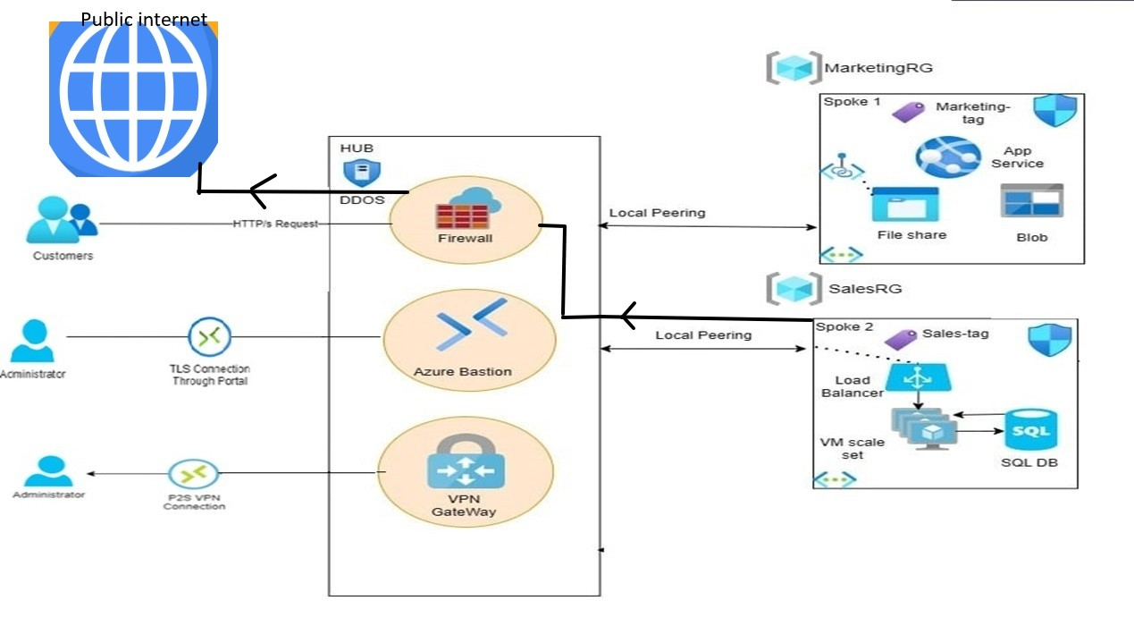
Traffic Direction
Outbound Traffic to Public Internet

Slide 21
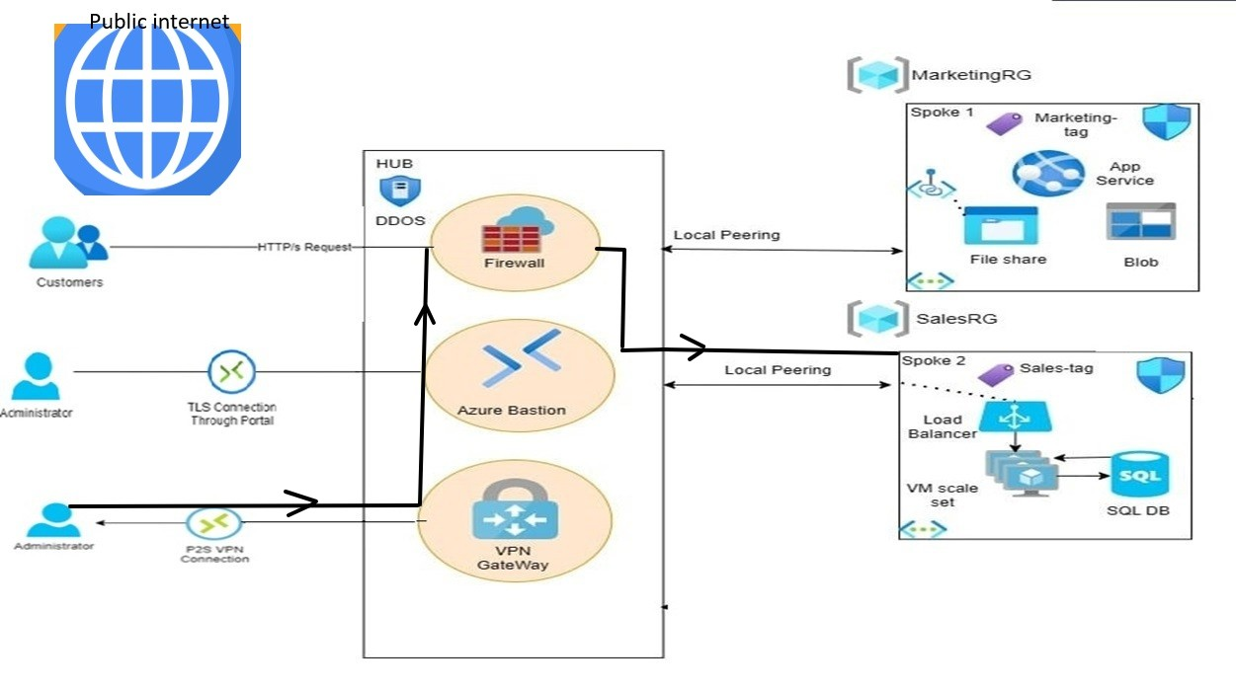
Traffic Direction
VPN User Traffic inside Network

Slide 22
Requirements
1- Integration of On-Premises and Cloud Resources
Requirement: Enable the client to manage both on-premises and cloud-based applications seamlessly.
Objective: Maintain part of the application on-premises while integrating it with the cloud infrastructure for unified management and operations.
Deliverables: Establish secure and efficient communication between the on-premises infrastructure and cloud services.
2- Tagging for Cost Management and Location Compliance
Requirement: Implement a system for tagging resources to track costs and enforce geographic deployment restrictions.
Objective: Ensure all resources are tagged with relevant information for cost optimization and to comply with approved geographic locations for resource deployment.
Deliverables:
Enforce tagging policies on all newly created resources for cost tracking.
Restrict resource deployment to specific geographic regions and prevent deployment outside approved locations.
Develop a process to monitor and manage tagged resources effectively.
3- Security Configuration for Internal Website Access
Requirement: Configure security rules to control access to an internal website from specific subnets.
Objective: Secure the internal website by limiting access to designated subnets only.
Deliverables:
Set up rules that permit traffic from approved subnets to access the internal website.
Block unauthorized traffic to maintain network security.

Slide 23
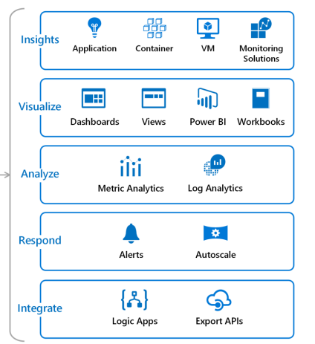
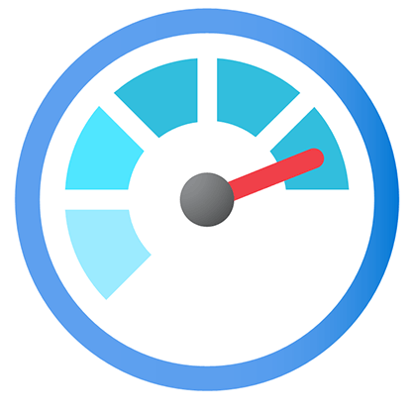
Monitoring Requirement: Implement a monitoring solution to track application performance and resource utilization across both on-premises and cloud environments.

Slide 24
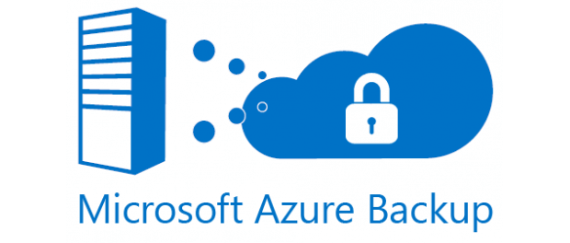
Azure Backup Requirement
Set up an automated backup solution to ensure data protection and disaster recovery for on-premises and cloud resources.

Slide 25
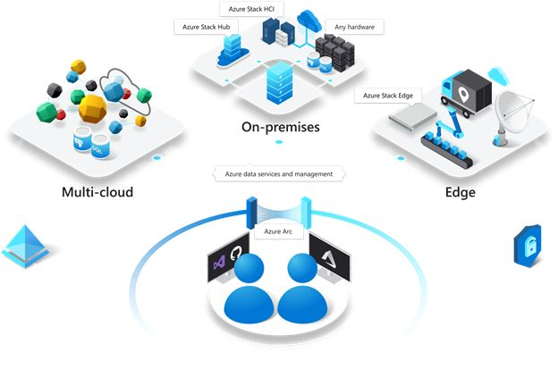
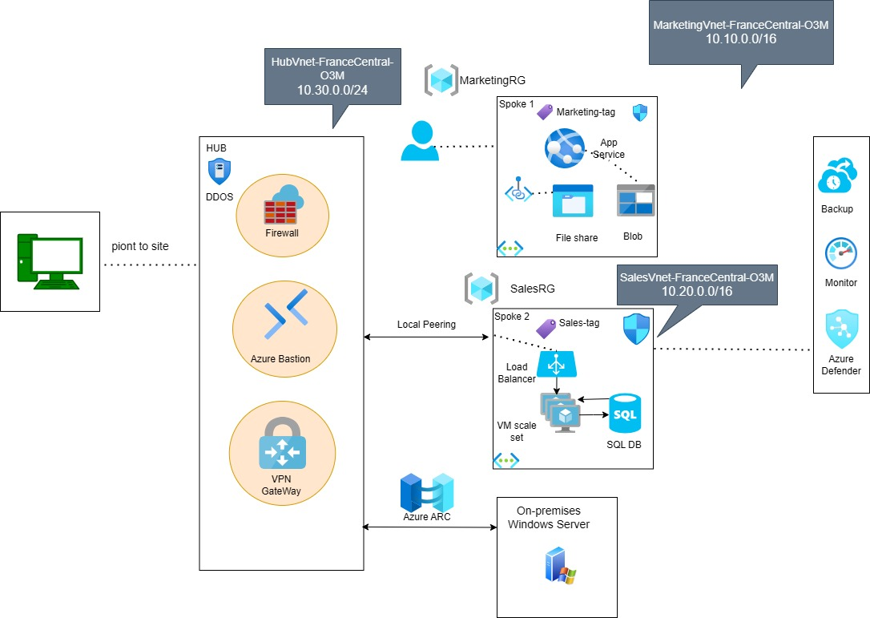
Azure Arc

Slide 26
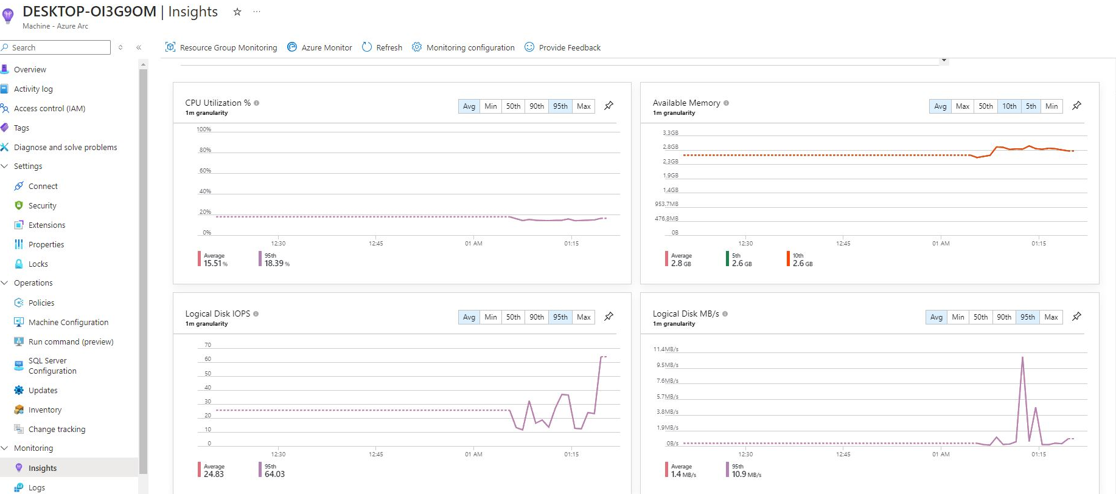

Slide 27
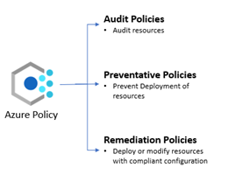
Azure Policy

Slide 28
Final Diagram

Slide 29
Project Demo

Slide 30

Any question?

Slide 31




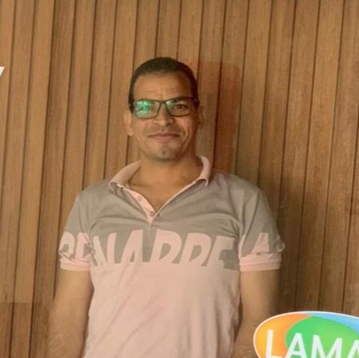
Thank You
Our Team Members
Mostafa Mina Omar Mahmoud

